Slide 1
Exercises of Chapter 5

Slide 2
Enzymes increase the rate of a reaction by ________.
C
A) increasing the temperature of the substrates
B) contributing electrons to the reaction
C) decreasing activation energy
D) changing the pH of the environment

Slide 3
(2) Which of the following processes could result in the net movement of a substance into a cell, if the substance is more concentrated in the cell than in the surroundings?
A
A) active transport
B) facilitated diffusion
C) diffusion
D) osmosis

Slide 4
(3) When a person cries, tears are exported from cells through the process of ________.
D
A) facilitated diffusion
B) active transport
C) endocytosis
D) exocytosis

Slide 5
The act of a white blood cell engulfing a bacterium is ________.
D
A) osmosis
B) diffusion
C) exocytosis
D) phagocytosis

Slide 6
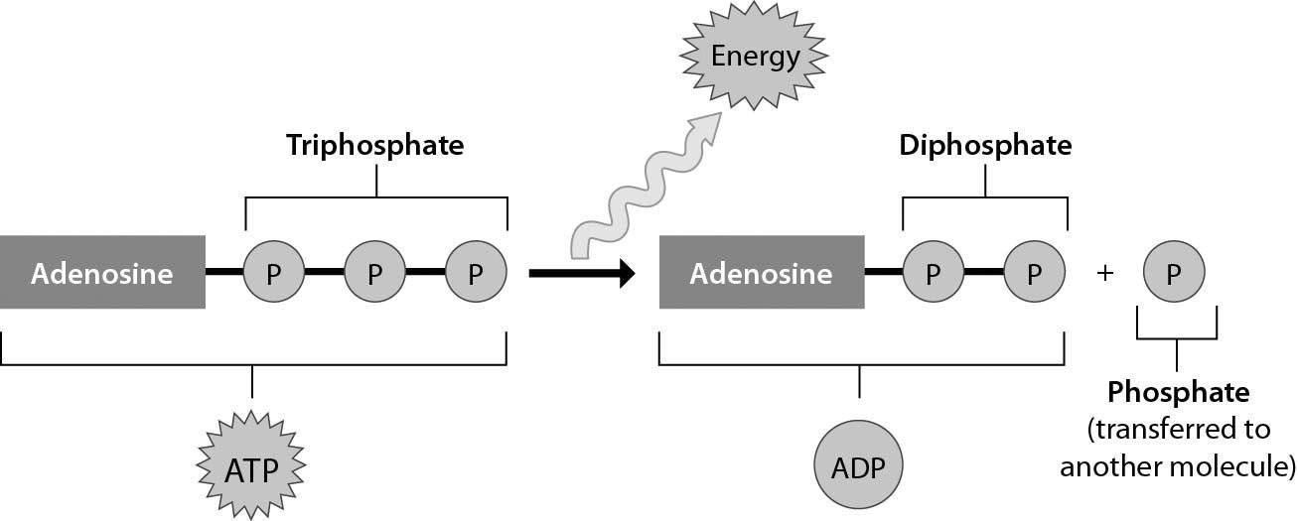
(5) The figure below shows that ________.
B
A) ADP can perform cellular work when it binds to an additional phosphate group
B) ATP can perform cellular work when it releases a phosphate group
C) ATP can be converted to ADP by adding a phosphate group
D) energy is released from ATP during the process of cellular respiration

Slide 7
(6) Which one of the following is TRUE?
A
A) An enzyme's function depends on its three-dimensional shape.
B) Enzymes work generally on a broad range of substrates.
C) Enzymes are used up in chemical reactions.
D) Enzymes emerge changed from the reactions they catalyze.

